Slide 1
Achieving a Data Science Career as a Female Precious Kolawole @precillieo

Slide 2
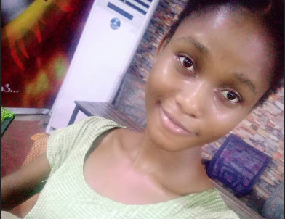
HELLO!
Machine Learning Engineering Intern at Lendsqr
Technical Writer
Dermatologist at night. Developer in the day

Slide 3

Challenges of Women In Tech

Slide 4

Nigerian Women are way too relaxed!
Leave Your Comfort Zone

Slide 5
Take up Space! “Opportunity is when luck meets preparation”

Slide 6
MY CAREER GROWTH
Go Live Precious. I love AI.
Learned to write Python Codes, right on my Phone.
Opportunity! Got into SCA, the mentor-mentee DS program
I now use PowerBI, Tableau & SQL. Can I call myself a Data Analyst already??
DSN 2020 AI Bootcamp started. Came up the 33rd best DS out of 750 DS that participated.
Built a DL model to tackle the problems faced by Doctors in Tanzania.
JAN
FEB
MAR
APR
MAY
JUN
JUL
AUG
SEP
OCT
NOV
DEC
Gained Admission into the University.
My brother was there for me as a mentor. I started Data Analysis.
Learning continues! Data Analysis, Visualization, got engaged in personal projects too.
Yay! I delved into Machine Learning. I can now build train and build models.
Sadly. SCA mentorship ended.
I won an award. Mrs. Algorithm as the best female DS in Nigeria.
Learning Continues!
Eww. I got a job as a Machine Learning Engineering Intern!!!

Slide 7
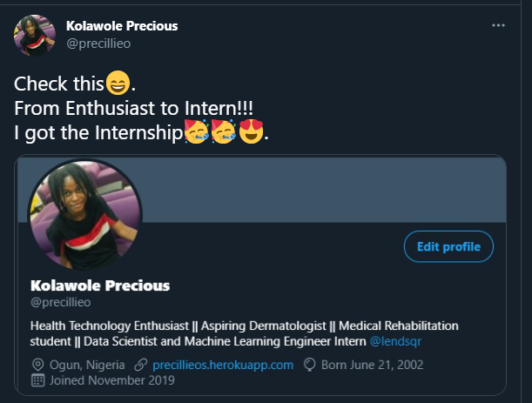
Machine Learning Engineer In a Year

Slide 8
In Summary
1.
challenge Yourself.
2.
Be Hungry for Greatness.
3.
Ask for Help.
4.
Embrace Opportunities.
5.
Join a Community.
6.
Publicise Yourself.

Slide 9
Thank You

